Slide 1


Vortex Microarchitecture
Blaise Tine
Notes:
Narration:
This poster presents Vortex, a reconfigurable and scalable RISC-V GPGPU accelerator.
Vortex’s main goal is to use RISC-V to utilize the advantages of SIMT execution model and provide a customizable design to facilitate architecture research.
In addition, we show that a minimal set of 5 instructions is enough to achieve a highly parallel execution model on RISC-V.
Single Instruction Multiple Threads execution model, or SIMT, has the advantage of having a scalar based programming model, which makes it easier to program on.
Through POCL, an open-source framework to implement the compiler and runtime software for OpenCL, we were able to execute unmodified OpenCL kernels on Vortex.
We achieved that by linking POCL with Vortex's runtime kernel, which provides warp and thread creation, warp barriers, and control divergence.
Vortex microarchitecture has two main configuration methods to scale for various application domains: increasing the number of parallel work-items and configuring the cache system. Each one of these methods has its own unique trade-offs, both in terms of performance for different applications and hardware and energy cost. The first method is to increase the parallel work-items in the design by either increasing the number of threads per warp, number of warps per core, number of cores per clusters, and the number of clusters. The second method is by configuring the cache system. Our L1, shared memory, L2, and L3 are all based on the same high-throughput banked design that supports a snoop protocol and prefetching.
We have evaluated our design both 15 nm educational library and Arria 10 Intel FPGA on a subset of Rhodina benchmarks and were able to achieve frequencies of 300 MHz and 192 MHz respectively.
In addition, we were able to fit a 2 cluster 8 core configuration with a total of 256 work units on Arria 10 Intel FPGA.
We also used the OPAE open-source accelerator API to be able to execute OpenCL kernels on the FPGA.

Slide 2
Agenda
ISA Extension
Microarchitecture
Hardware Scaling and Configuration
High-Bandwidth Caches
Tensor Cores

Slide 3
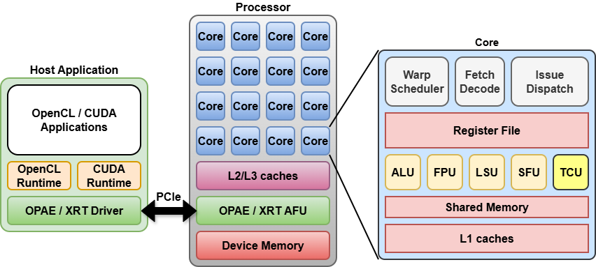
Vortex GPGPU Platform
Hardware
Fully configurable multi-core GPU
PCIe host-device interface
Floating-point Units, caches & shared Memory
32 and 64-bit ISA
Open-source toolchain
LLVM: Compiler
POCL: OpenCL
CuPBoP: CUDA
OPAE: Intel FPGA API
XRT: Xilinx FPGA API
Verilator: RTL simulation
Yosys: RTL Synthesis
FPGA Synthesis
Altera: Arria10, Stratix 10
Xilinx: Alveo U50, U250, U280, U55

Slide 4
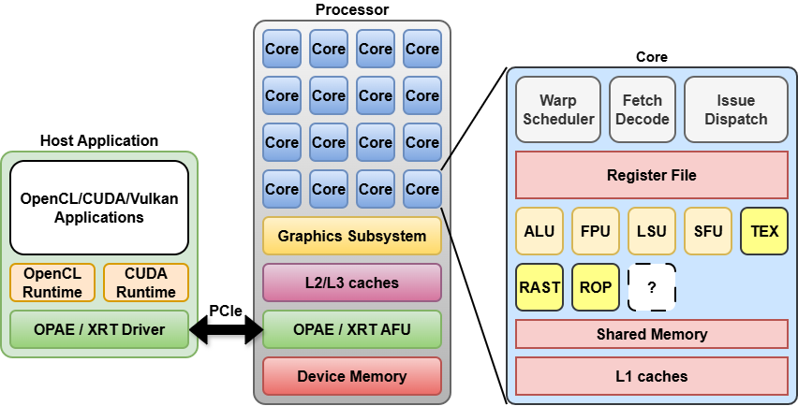
Vortex GPGPU Platform (Skybox)
Hardware
Fully configurable multi-core GPU
PCIe host-device interface
Floating-point Units, caches & shared Memory
32 and 64-bit ISA
Open-source toolchain
LLVM: Compiler
POCL: OpenCL
CuPBoP: CUDA
OPAE: Intel FPGA API
XRT: Xilinx FPGA API
Verilator: RTL simulation
Yosys: RTL Synthesis
FPGA Synthesis
Altera: Arria10, Stratix 10
Xilinx: Alveo U50, U250, U280, U55

Slide 5
RISC-V ISA Extension for Vortex
Threading model
Wavefronts
Threads
Thread Divergence Handling
Split/Join stack based
Thread predication
Memory model
Global memory
Shared memory
Register File
RISC-V Integers and floats
32 * #warps * #threads regs
Synchronization
Global and local barriers
RISC-V fence
Instruction | Description
wspawn #warps, %PC | Wavefronts activation
tmc #threads | Thread mask control
#addr ← split #pred | Control flow divergence
join #addr | Control flow reconvergence
pred #pred, #mask | Thread predication
bar #id, #warps bar #id, #cores | Wavefront local barrier (positive id) Wavefront global barrier (negative id)

Slide 6
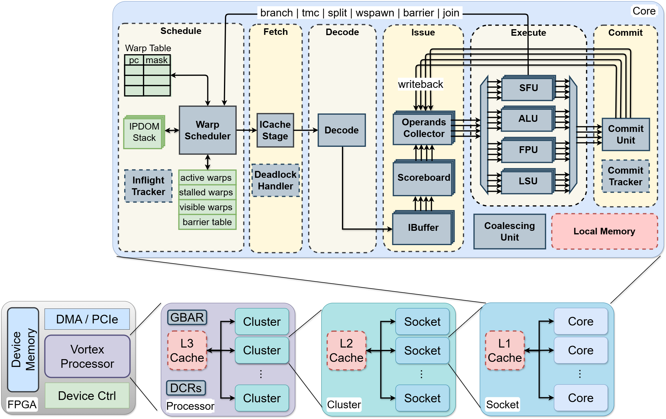
Vortex GPU Microarchitecture
Six-stage RISC-V
in-order issue
out-of-order commit Pipeline

Slide 7
Vortex GPU Microarchitecture (2)
Schedule Stage
Warp scheduler
Warp Table
IPDOM Table
Inflight Tracker

Slide 8
Vortex GPU Microarchitecture (3)
Fetch Stage
Icache Request
Deadlock avoidance
Cacheless only

Slide 9
Vortex GPU Microarchitecture (4)
Decode Stage
Decode instruction
Unlock warp
!branch
!csrs
!wctl

Slide 10
Vortex GPU Microarchitecture (5)
Issue Stage
Instruction Buffer
Scoreboard
Operands Collector
Dispatch

Slide 11
Vortex GPU Microarchitecture (6)
Execute Stage
ALU cluster
FPU cluster
LSU cluster
SFU cluster

Slide 12
Vortex GPU Microarchitecture (7)
Commit Stage
Per-unit gather
Writeback
Commit tracker

Slide 13
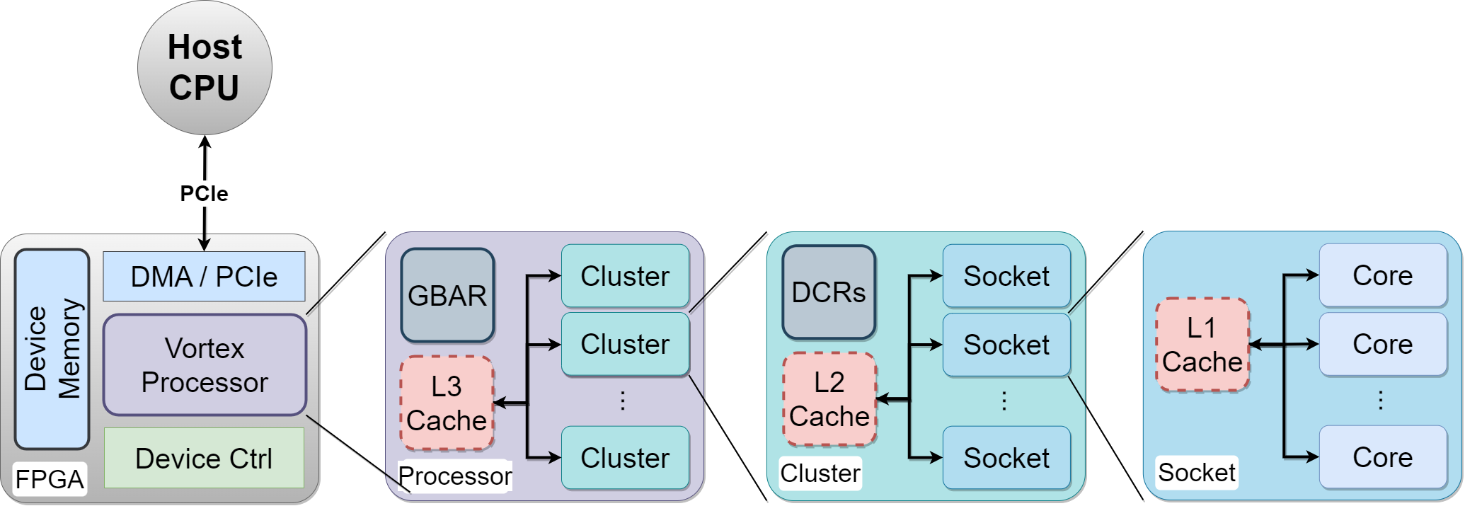
GPU Hierarchical Clustering
Socket
Multiple cores
Optional L1 cache
Cluster
Multiple sockets
Optional L2 cache
Processor
Global barrier
Optional L3 cache
FPGA
Vortex Processor
Device Controller
DMA/PCIe Controllers
Device Memory

Slide 14
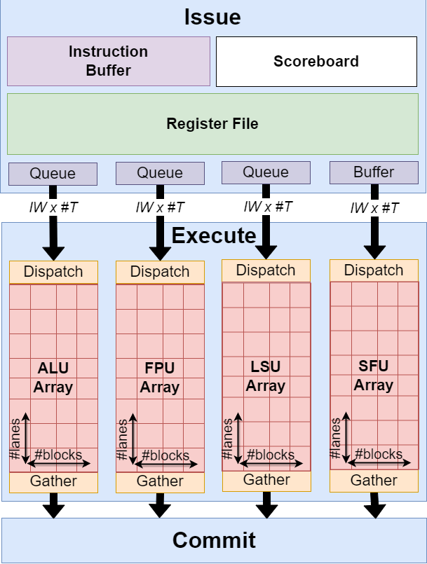
Execute Stage
Dispatch Queues
Flow control
Per execute unit
Dispatch Unit
Read IW x #T data from queue
Send #Block x #lanes data to array
Per execute unit
Gather Unit
Merge outputs from array
Return IW x #T results
Per execute unit

Slide 15
Compute Scaling
Pipeline Configuration
Number of wavefronts (#W)
Number of threads (#T)
Issue width (IW)
Execute Unit Configuration
Number of blocks (#B)
Number of lanes (#L)
Dispatch Capacity
IW * #T total work items
Compute Capacity
#B * #L total processing element
Full Compute Capacity
#B=#IW and #L=#T

Slide 16
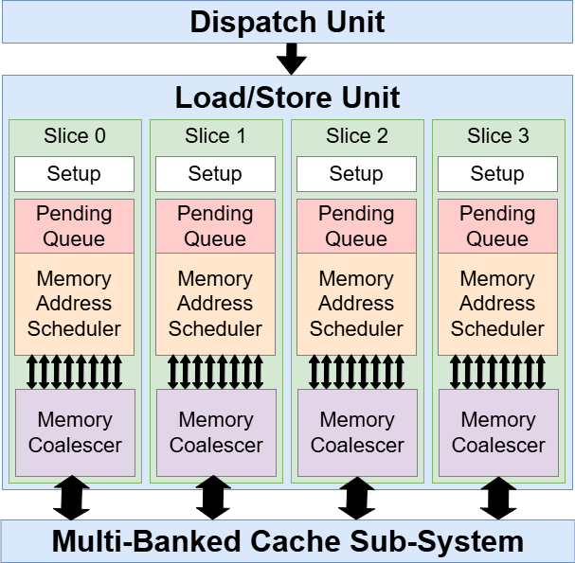
Memory Scaling
Load/Store Unit Configuration
Number of slices (#B)
Number of lanes (#L)
Dispatch Capacity
IW * #T total work items
Memory Capacity
#B * #L total requests
Full Memory Capacity
#B=#IW and #L=#T

Slide 17
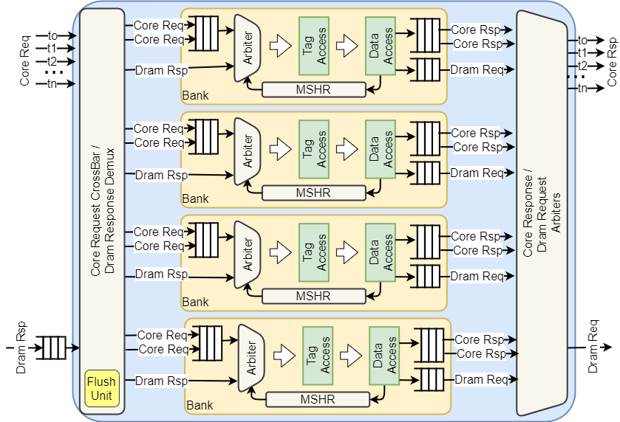
Vortex High-bandwidth Caches
High-Performance
Multi-banked
Non-blocking operation
Highly Configurable
Highly Configurable
Banking
Associativity
Write-back / Write-through
Dirty bytes
Eviction Policy
Hierarchical Flush
Pipeline Queues

Slide 18
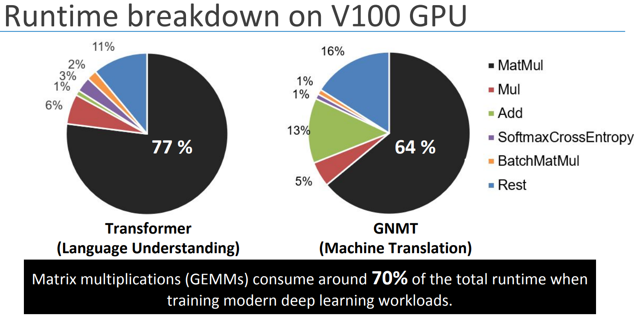
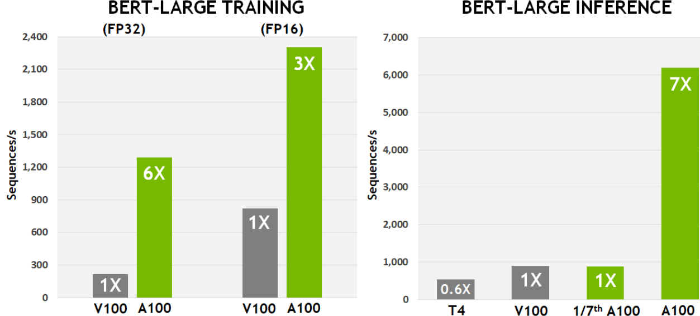
Tensor Cores
AI Revolution
AI Explosion with LLMs
MatMul is the core workload
70% total runtime in training
Need perf. scaling and efficiency
GPU Specialization
Specialized MMA data paths
Precision-aware speed-up
Mixed precision formats
Proven step-function gains
Micro-architecture innovations
https://ieeexplore.ieee.org/document/9065523

Slide 19
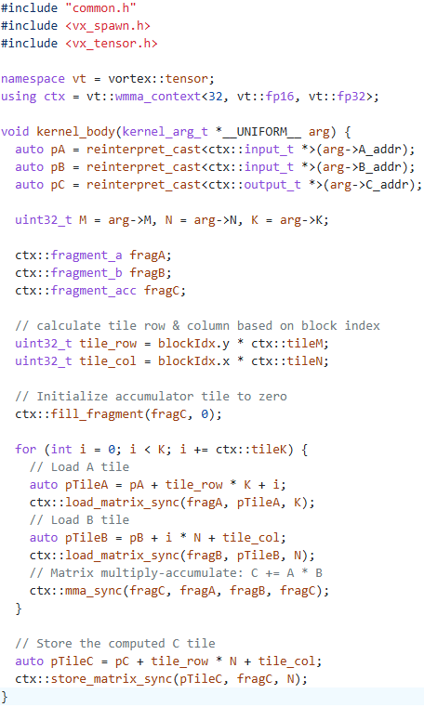
Vortex Tensor API
Tensor Library
Include header
Template parameters
Context object
Number of threads
Input format
Output format
Namespace definitions
Fragment objects
Matrix load / store functions
Matrix multiply-add function

Slide 20
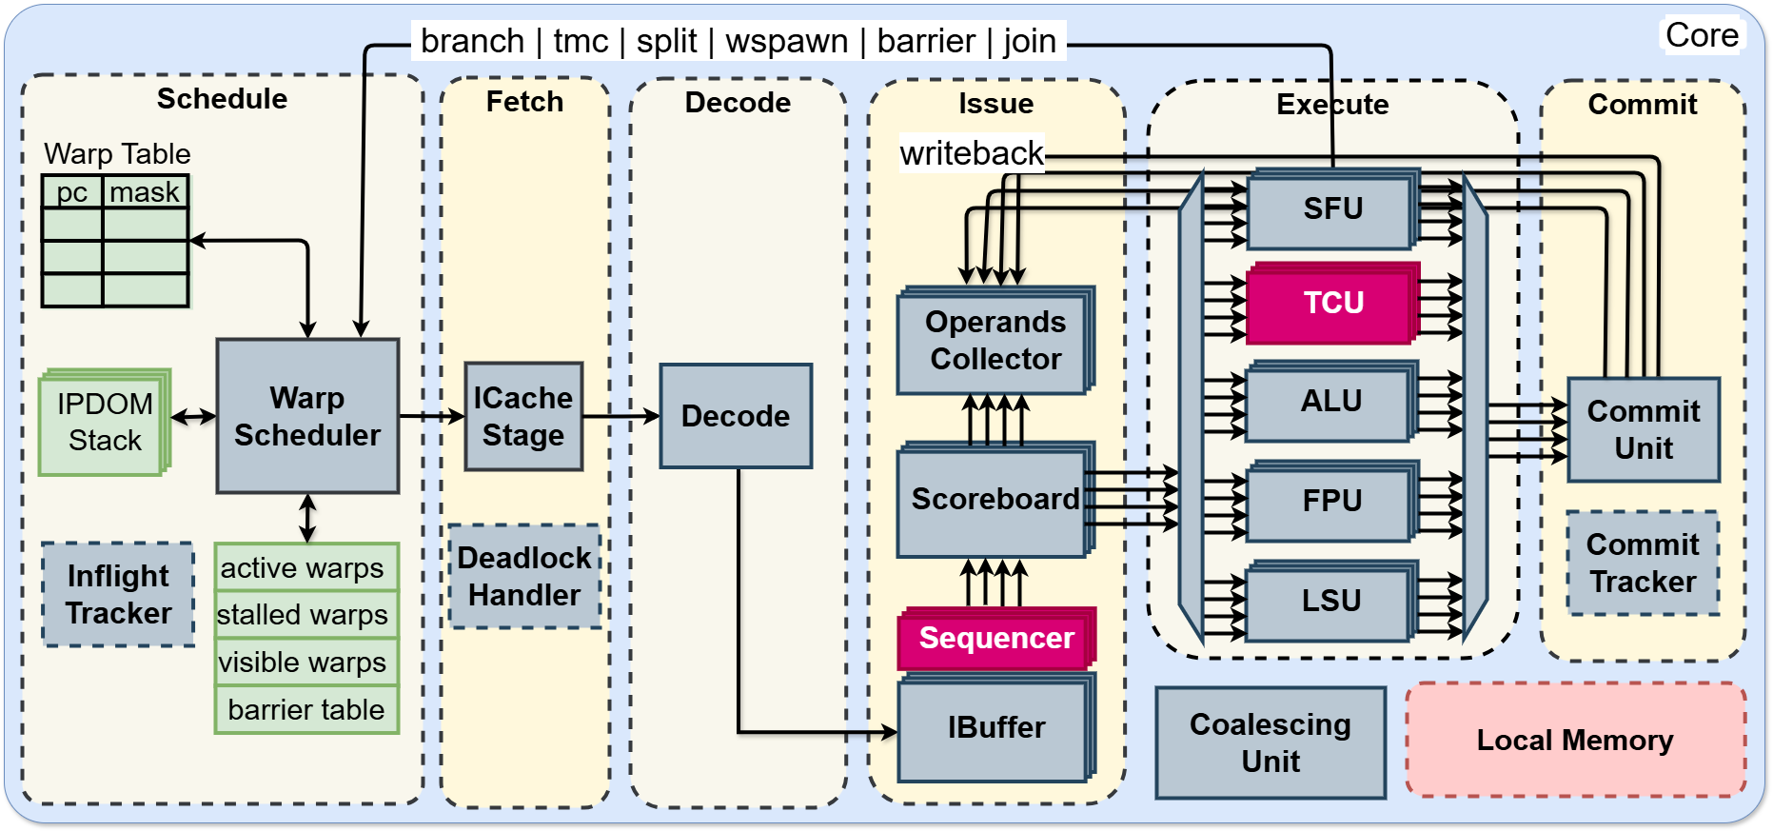
Pipeline Extension for Tensor Cores
Sequencer
TC µops Generator
Bypass mode
Tensor Core Unit
Multiple instances
Dual pipelines
Integers
Floating points
Multiple backends
DPI
Xilinx DSP
Berkely Hardfloat

Slide 21
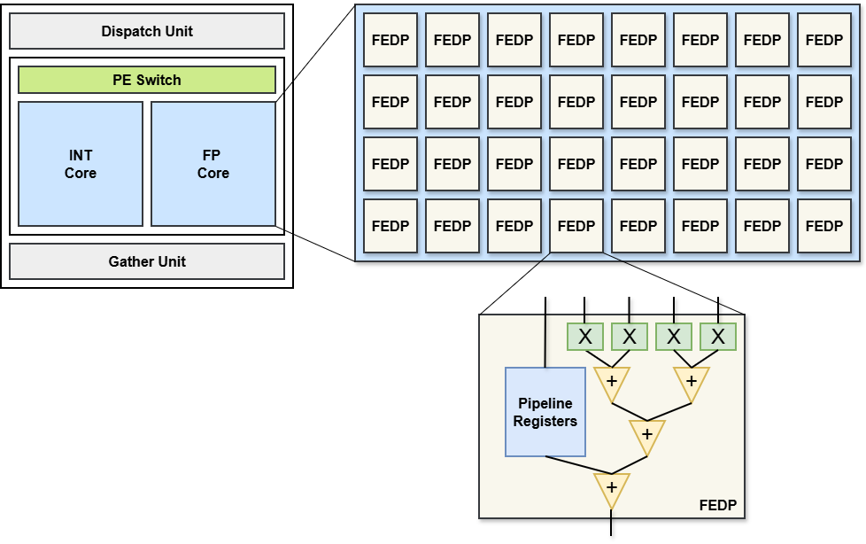
Tensor Core Microarchitecture
Tensor Unit
Dispatch unit
PE switch
Integer Core
Floating Point Core
Gather unit
Fused-Element Dot Product
Multipliers
Adder Tree
4-cycle Pipeline (DPI, INT)
C
A₀,B₀
A₁,B₁
A₂,B₂
A₃,B₃
D

Slide 22
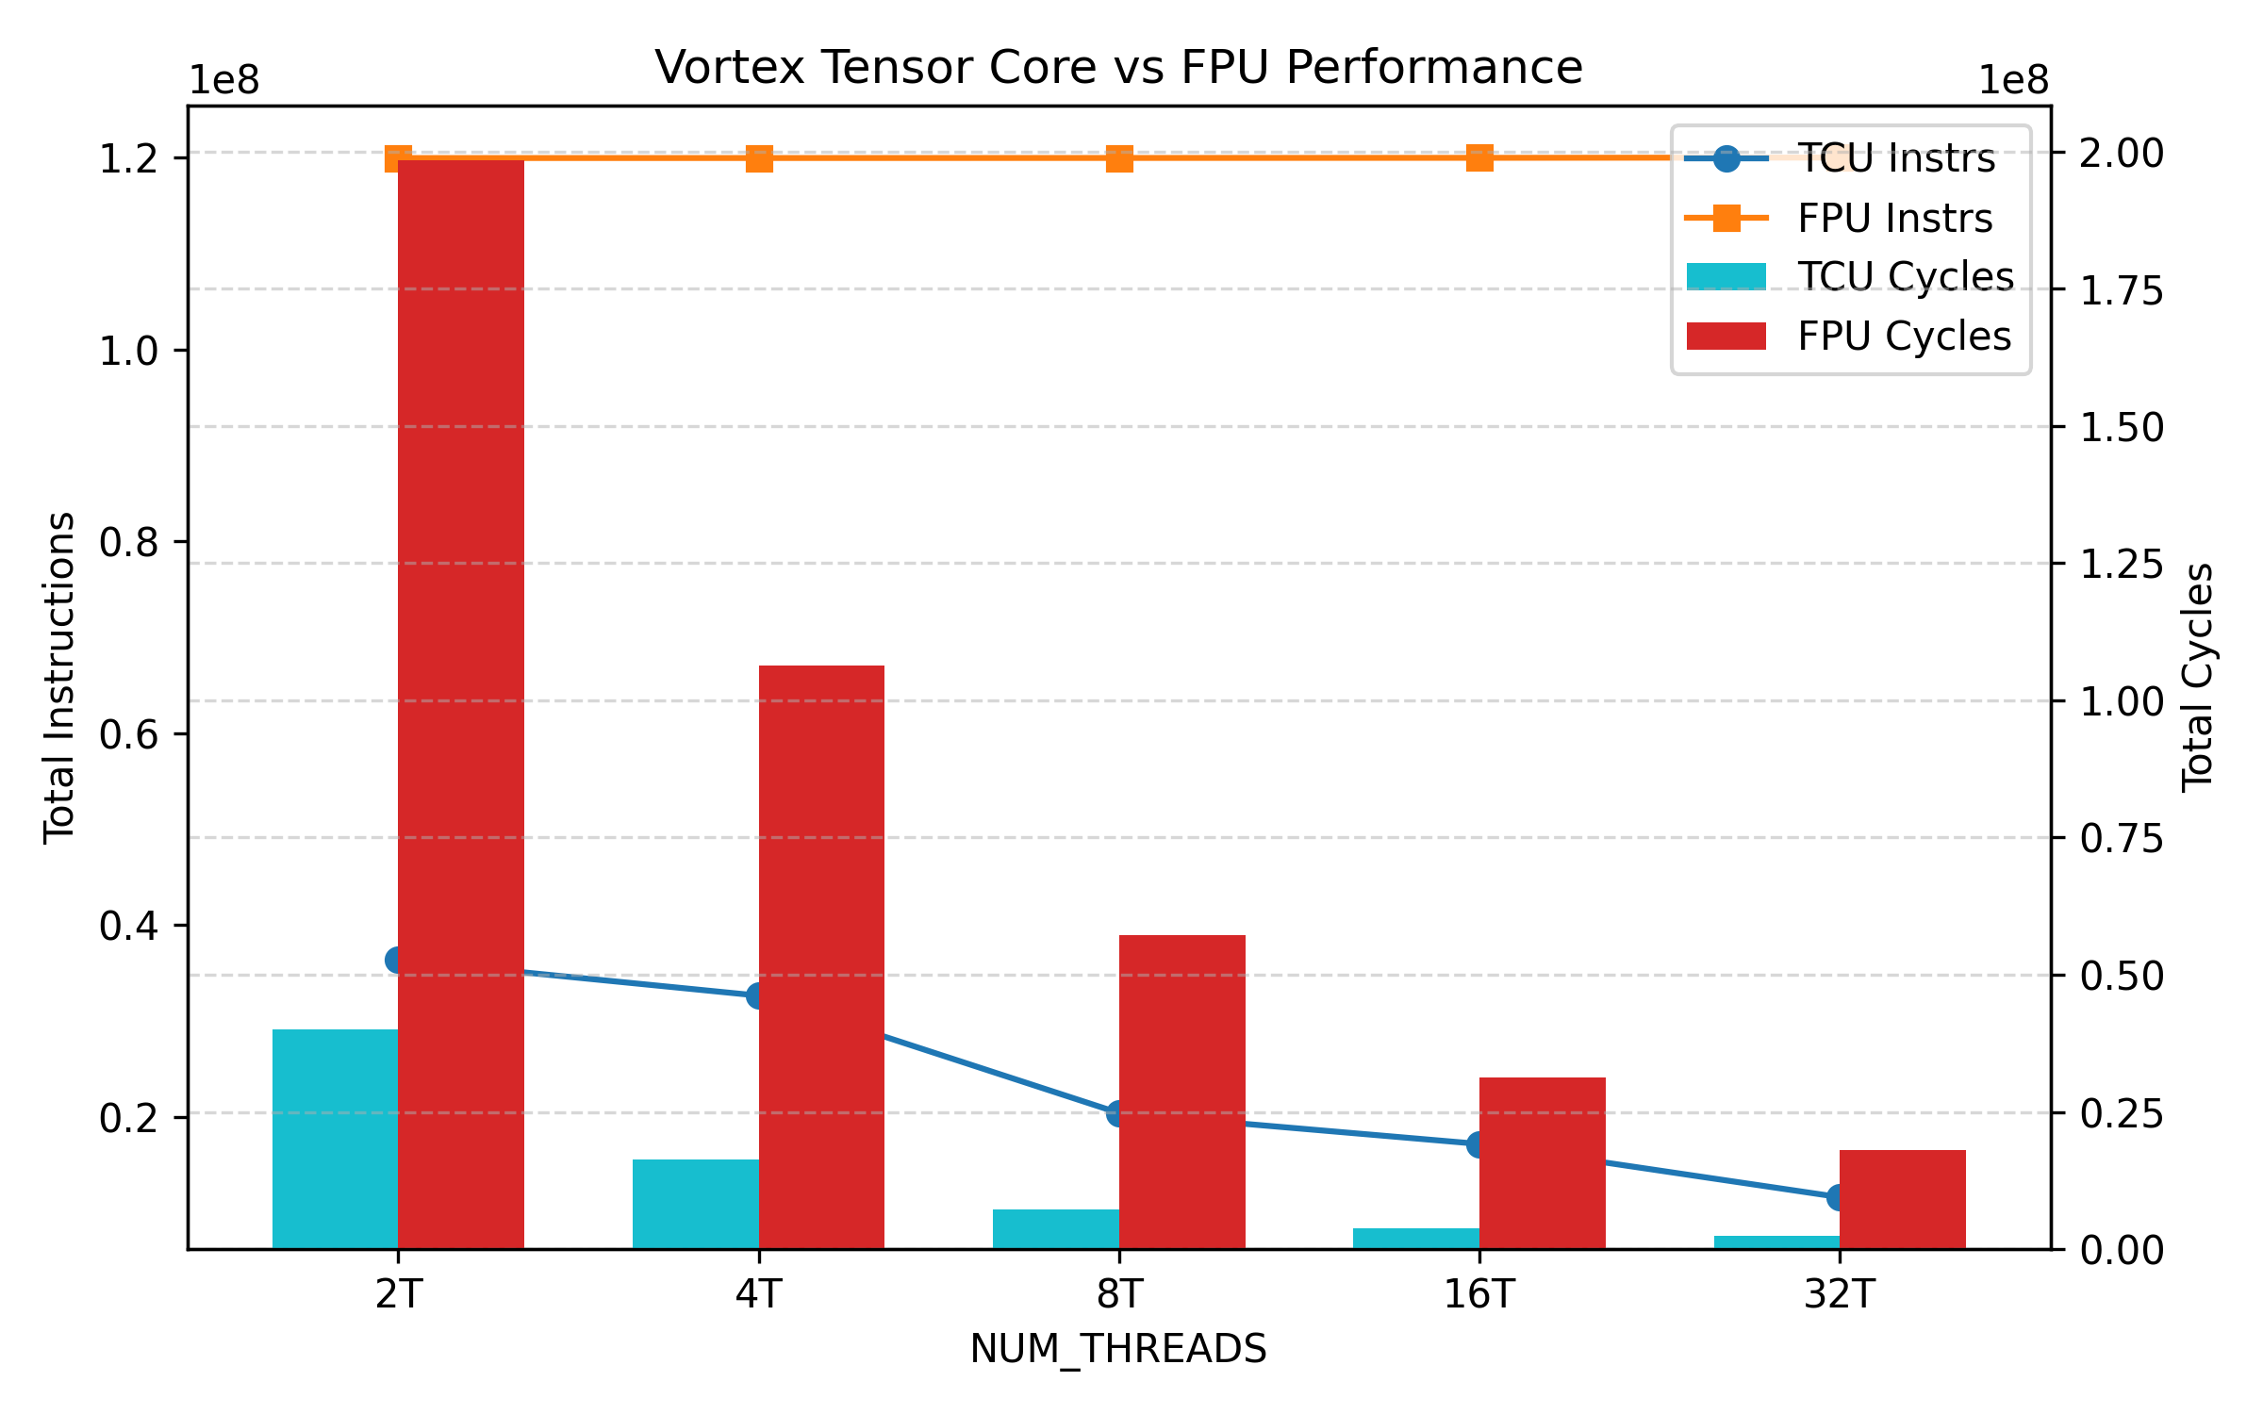
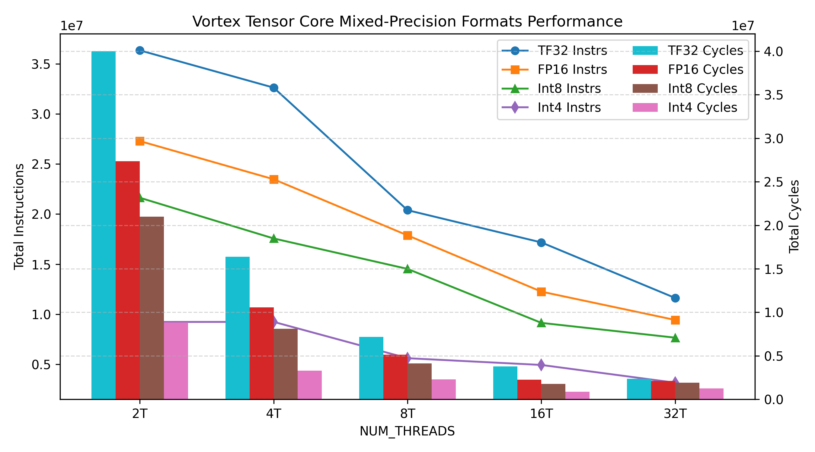
Tensor Core Performance
TC vs FPU pipeline
256x256 matrix tiles
8-warp GPU @ 300 MHz on U55C
TC size = 8x4x4 = 128 FMA’s
TF32 vs FP32
5x to 8x faster
67% to 90% fewer instrs
Mixed-precision formats
TF32, Fp16, Int8, Int4
1x → 1.7x → 2.1x → 4.9x

Slide 23
Thank You!

